Slide 1
College Scorecard Data
Adrian Hinojosa

Slide 2
Agenda
Question
Action/College Score Card
Data
Data Cleaning
Data Set
Variables
Data Visuals
Linear Regression
Decision Tree
Random Forest
Comparison/Final Results

Slide 3
Question
What are the Predict Earnings after some time after college?

Slide 4
Action and Motivation
Create a model with features (I think) that contribute to Median Earnings
Evaluate and find important Features

Slide 5
College Scorecard
https://data.ed.gov/dataset/college-scorecard-all-data-files-through-6-2020/resources
Most Recent Institution Level Data
1997-2019

Slide 6
Data
College Scorecard Data most recent data
Rows = 6806
Columns = 2384
Missing Values 2736625
Columns divided into Categories Academics, Admissions, Aid, Costs, Earnings, repayment, School, Student

Slide 7
Data Cleaning
Using the College Scorecard Dictionary Found Variables Manually after doing some initial Visualization
Dropped the features Down from 2384 to 48 then to 12 for the Machine Learning Model
Dropped NA variables
Privacy Suppression Variables most of the demographics.
Assigned Column Names
Data Visualization Grouped by Categorical Variables
Dropped Categorical variables from Machine Learning Model

Slide 8
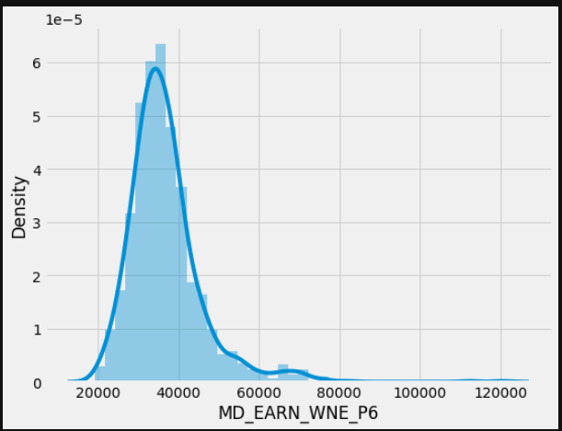
Data Set
Rows : 1242
Columns : 12
Missing values : 0
Unique values :
MD_EARN_WNE_P6 333
GRAD_DEBT_MDN 523
C150_4 1123
AVGFACSAL 1135
TUITIONFEE_IN 1169
TUITIONFEE_OUT 1164
SAT_AVG 438
CDR2 170
Engineering 433
BioMedical 755
Health_Professions 820
Communication 613

Slide 9
Variable Selection
Ran a random forest with model with all available Majors and selected the top important variables most of the Majors except for 4 of them had an importance value.
Studied the Dictionary and Picked Variables from Different Categories to avoid Multicollinearity
Avoided the Earnings Category
Assumptions made Debt has an effect on Earnings

Slide 10
Features
Graduation Debt
Completion Rate
Avg Faculty Salary
Tuition Fee In State
Tuition Fee Out of State
Average SAT Scores
Default Rate after 2 years out of school
Engineering Major
Biology or Medical Major
Health Professionals
Communications

Slide 11
Dependent Variable
MD_EARN_WNE_P6 = Median Earnings after 6 years
Adjusted for inflation to 2017 dollars by Ed Scorecard
count 1221.000000
mean 36720.065520
std 9264.982478
min 19200.000000
25% 31200.000000
50% 35300.000000
75% 40100.000000
max 120400.000000

Slide 12
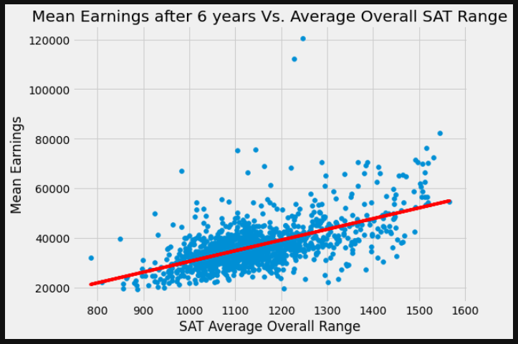
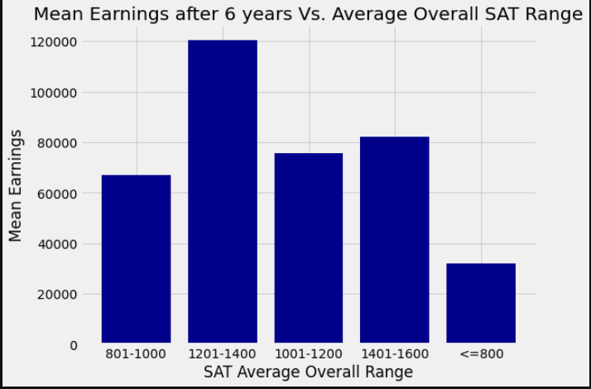
Graphs

Slide 13
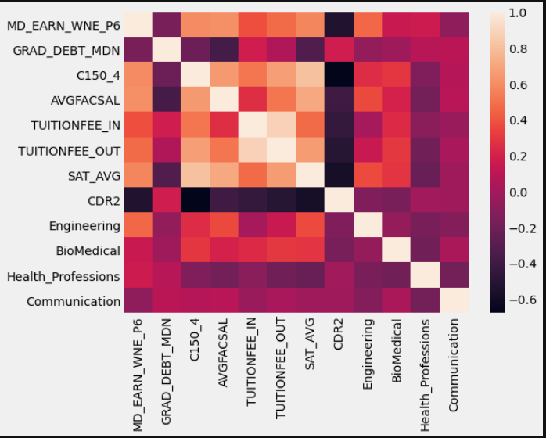
Heat Map

Slide 14
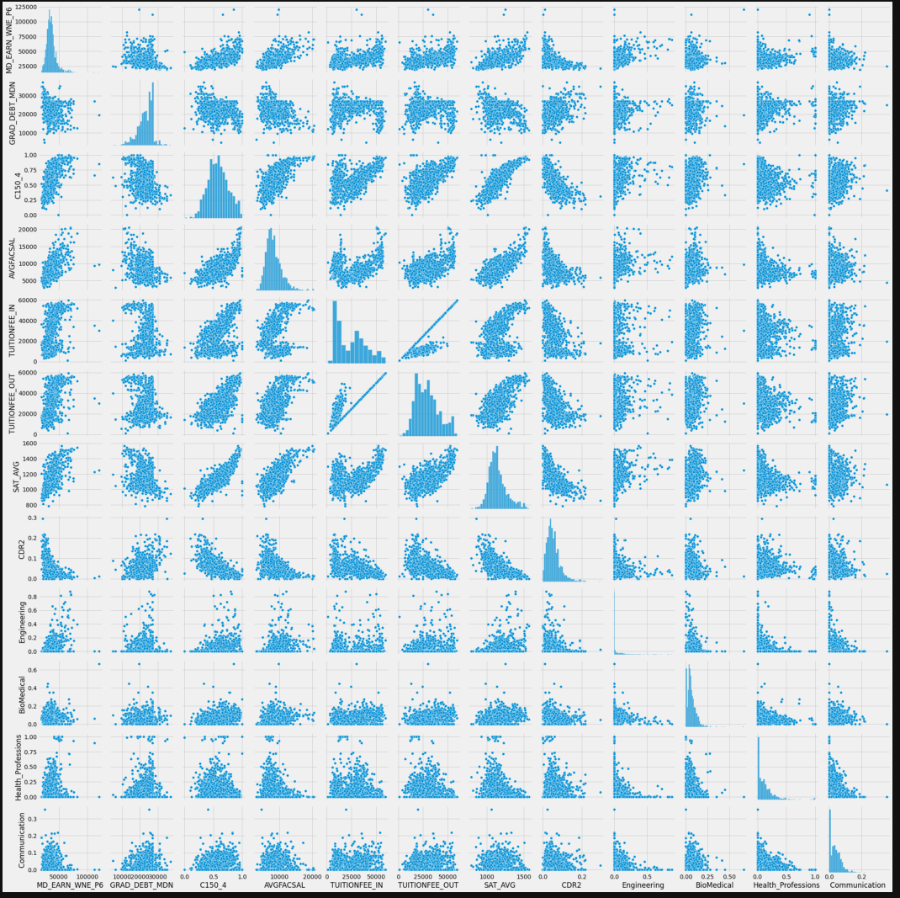
Pairplot

Slide 15
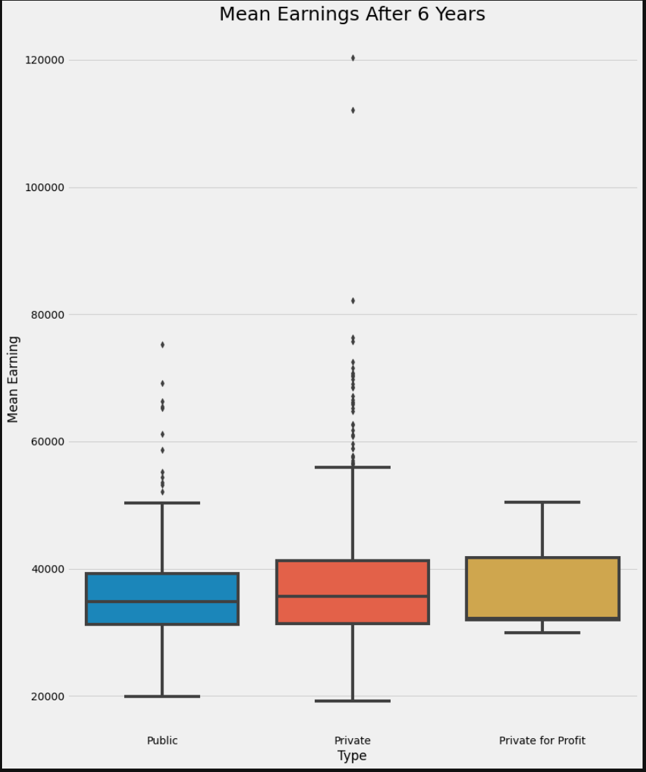
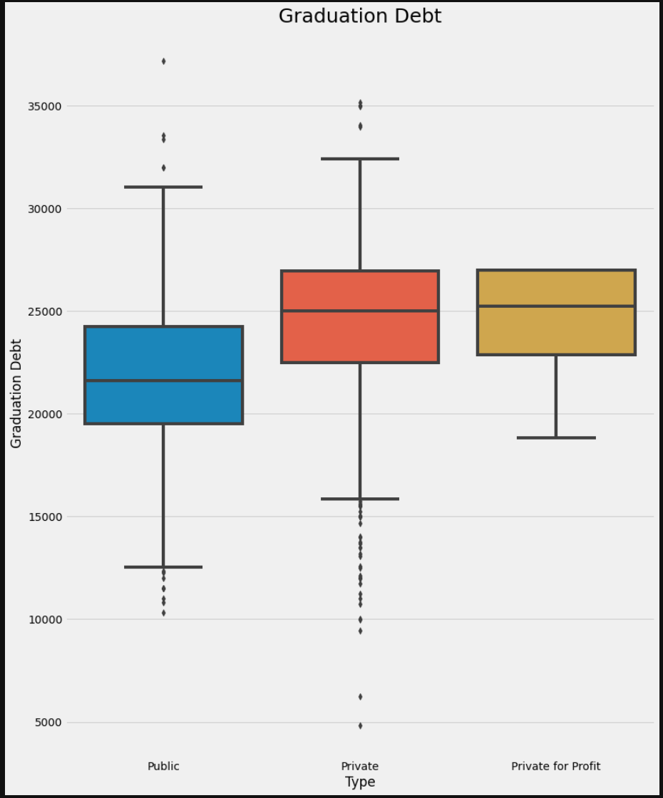
Box Plots

Slide 16
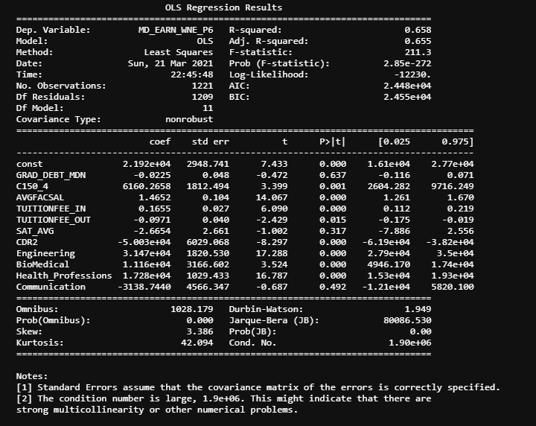

Linear Regression
$y=β0+β1x1+ …β11x$₁₁
Multicollinearity
Numerical Problems
Moved on to the Next Model
Score .65
Train Test Split
Tried to adjust but no improvement

Slide 17
Decisions Tree

Slide 18
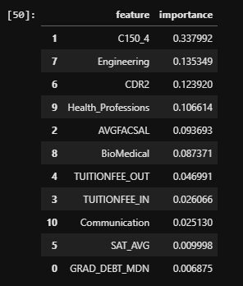
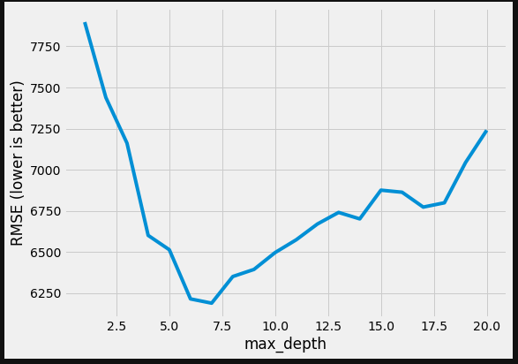
Decision Tree Model
Baseline RMSE 9094
Grid Search Max Depth Range of 7 features
Ran with 7 features
Grid search Score .85 with best parameters CV = 10
Completion Rate was important
Engineering seemed to matter

Slide 19
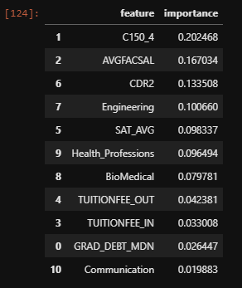
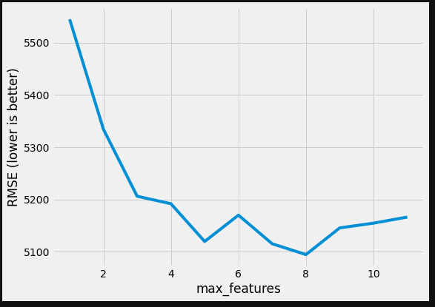
Random Forest
Baseline Score .94
Feature Importance Changed
Completion Rate
Grid Search CV
N = 230
8 Max Features
Model Improved from .94 to .96

Slide 20
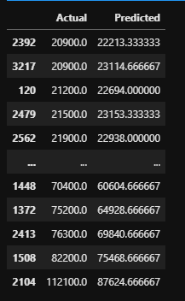
Actual V Predicted

Slide 21
Best Model
Random Forest provided the best results
 | Linear Regression | Decision Trees | Random Forest Score
Baseline Score | .65 | .75 | .94
Score | .65 | .85 | .97
Best N features | NA | 7 | 8
RMSE | 4611.96 | 6188 | 5097

Slide 22
Conclusions
Completing a Degree has some affect on Earnings
Majors have some affect on Earnings
Relationship between Debt and Earnings is Inverse

Slide 23
Future Work
Feature Selection
Use all the data Set to predict median earnings
Import the Dictionary join with the data set
Find the College
Compare with Debt
Adjust for Dummy Variables and Weighted Values in Linear Regression
API
JSON

